Slide 1


Goroutines demystified.
Internals of goroutines, threading & scheduling
Gufran Mirza
gufranmirza

Slide 2
Goroutines??
A goroutine is a lightweight thread managed by the Go runtime. They are called lightweight threads because they require less processing time
Smaller default stack size
Lighter context switching :
  setup and teardown don’t require call to the kernel

Slide 3
OS Threads??
The POSIX thread API is very much a logical extension to the existing Unix process model and as such, threads get a lot of the same controls as processes. Go does not give access to OS-Threads because
Complexities involved in managing an OS-Thread
OS can't make informed scheduling decisions, based on the Go model

Slide 4
User-threads
Ok, so basically they are just user threads : an implementation of threads and scheduling running on top of the OS.
But wait how is this a good idea ?
Why is it cool to reimplement something already provided by your kernel ?

Slide 5
User-threads ideas
Some nice ideas to make profit of user threads :
Allocate kernel threads when creating the first user threads.
Park for reuse the kernel threads after the user thread ends.
Schedule user threads to run on respecting kernel threads.
Lightweight in terms of setup and teardown cost

Slide 6
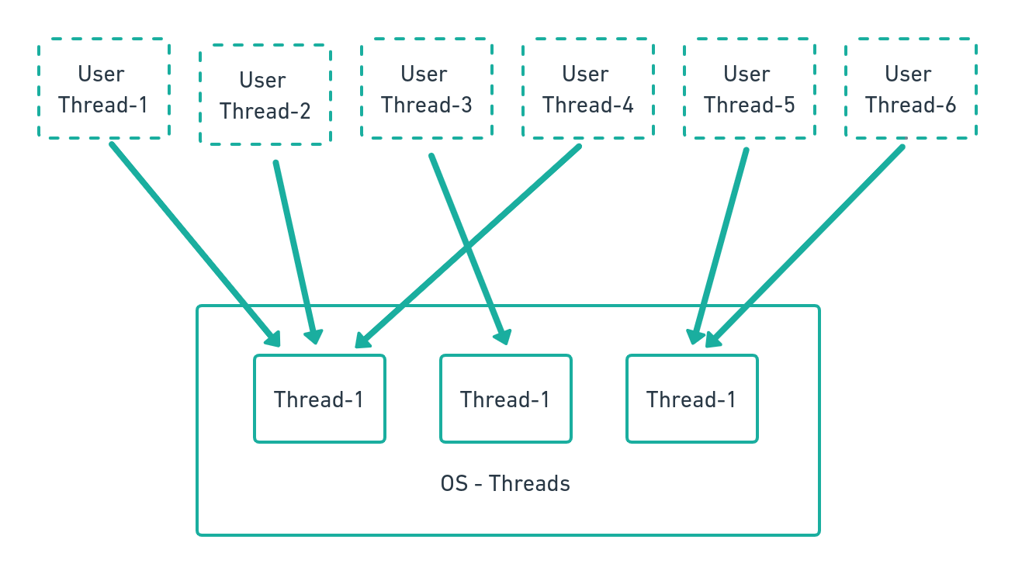
User-threads implementation
Multiplexing low-cost user-threads on high-cost kernel threads :

Slide 7
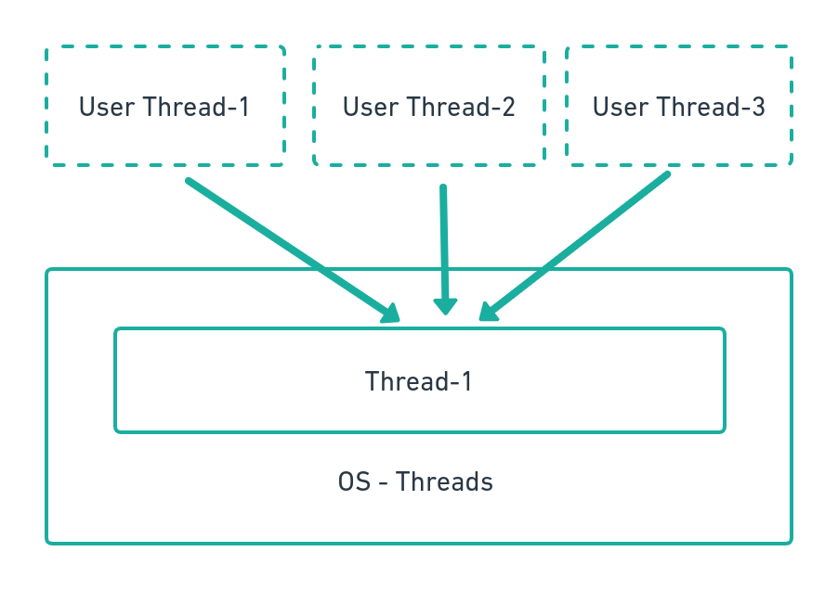
User-threads implementation
Multiple user thread can run on the same associated kernel thread.

Slide 8
Go Scheduler
The scheduler manages a runqueue of runnable goroutines.
When it wants to schedule a goroutine it pops it out of the runqueue and schedules it on a available kernel thread
Instantiating kernel thread if needed and possible.

Slide 9
Go Scheduler - Expectations
How to distribute these multiple goroutines over multiple OS threads that run on the available CPU processors. In what order these multiple goroutines should run to maintain fairness?
Should be Parallel and Scalable and Fair.
Should be Scalable to millions of goroutine per process (10⁶)
Memory Efficient. (RAM is cheap, but not free.)
System calls should not cause performance degradation

Slide 10
Go Scheduler
Go implements theses concepts through 3 important structures in the runtime code We can say X goroutines : Scheduled on Y threads : that runs on Z processors:
The G struct (Goroutine) | The M struct (Kernel Thread) | The P struct (Linked List/Processor)
- Represents a runnable goroutine - Contains informations about its stack - Its current status and its associated P | - Represents a kernel thread - Contains two important pointers: - One to the currently running G and - Another one to its attached P. | - Represents a scheduling context - Contains a list of runnable Gs.

Slide 11
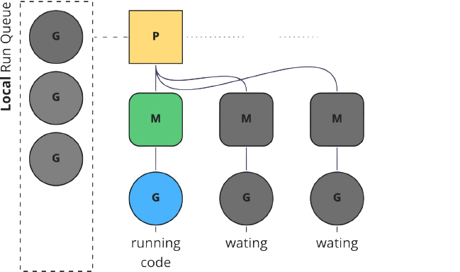
Go Scheduler
Its job is to distribute runnable goroutines (G) over multiple worker OS threads (M) that run on one or more processors (P). Processors are handling multiple threads
Thread
Goroutine

Slide 12
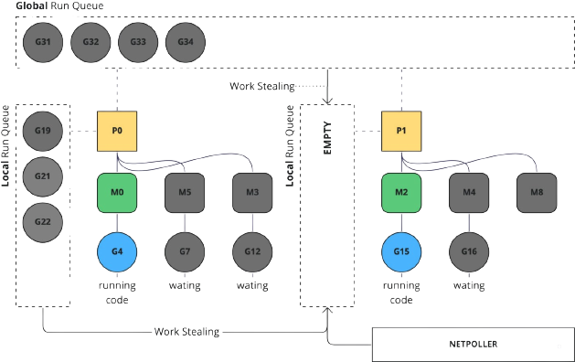
Goroutines queues
Go manages goroutines at two levels, local queues and global queues. Local queues are attached to each processor, while the global queue is common.

Slide 13
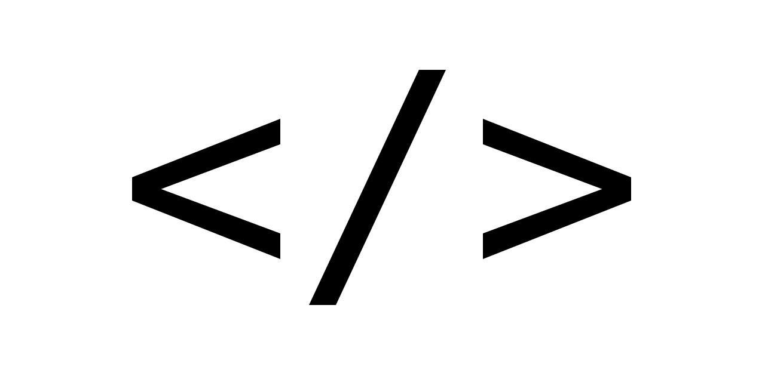
Demo

Slide 14
Work-stealing
When a processor does not have any work, it applies the following rules until one can be satisfied
Pull work from the local queue
Pull work from the global queue
Pull work from network poller
Steal work from the other P’s local queues

Slide 15
Work-stealing
P1 is looking for work. However, its local queue, the global queue has some G, and the network poller are empty. The last solution is to steal a job from global queue:

Slide 16
Demo

Slide 17
Blocking Calls
The Blocking SYSCALL method is encapsulated between runtime.entersyscall(SB) runtime.exitsyscall(SB)
In a literal sense, some logic is executed before entering the system call, and some logic is executed after exiting the system call.
This wrapper will automatically dissociate the P from the thread M when a blocking system call is made and allow another thread to run on it.

Slide 18
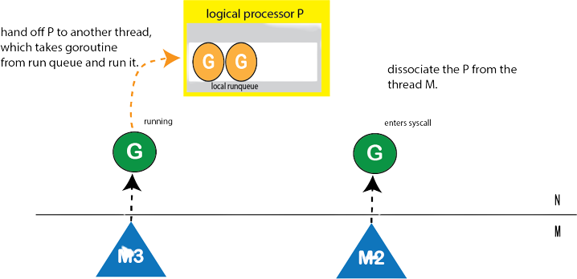
Blocking Hadoff
The way we can restore parallelism is that when we enter the system call, we can wake up another thread, which will select the runnable goroutine from the run queue.

Slide 19
Blocking Exit
What happens Once blocking syscall exits?
Runtime tries to acquire the exact same P, and resume the execution.
Runtime tries to acquire a P in the idle list and resume the execution.
Runtime put the goroutine in the global queue and put the associated M back to the idle list.

Slide 20
Demo

Slide 21
Questions ?

Slide 22
Credits
https://medium.com/a-journey-with-go/go-work-stealing-in-go-scheduler-d439231be64d
https://betterprogramming.pub/deep-dive-into-concurrency-of-go-93002344d37b
https://medium.com/@ankur_anand/illustrated-tales-of-go-runtime-scheduler-74809ef6d19b
https://github.com/golang/go/wiki/Performance#scheduler-trace
https://www.matoski.com/article/golang-profiling-flamegraphs/
https://github.com/gufranmirza/talks/tree/main/2022/03-go-routines-scheduling

Slide 23


Contact me
Gufran Mirza
Software engineer @IBM Cloud
@_imGufran
@gufranmirza

